Slide 1
Introduction
Emanuele Della Valle
Prof. @ Politecnico di Milano
Founder & Partner @ Quantia Consulting
Marco Balduini
Founder & CEO @ Quantia Consulting
Riccardo Tommasini
Prof. @ University of Tartu

Slide 2




It's a streaming world …
Off-shore oil operations
Smart Cities
Social networks
E. Della Valle

Slide 3
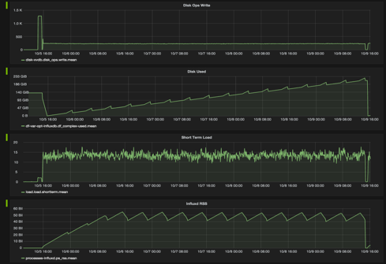
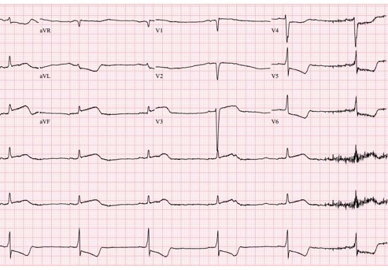
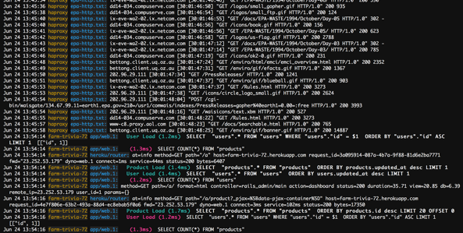
… full of …
data streams,
time series,
metrics, and
events!
E. Della Valle

Slide 4
… looking for historical descriptive analysis …
What is the average time to failure for the different brands of turbine in use?
What is the maximum delay of the public transport per city district?
Which content features are correlated to high impact posts?
E. Della Valle

Slide 5
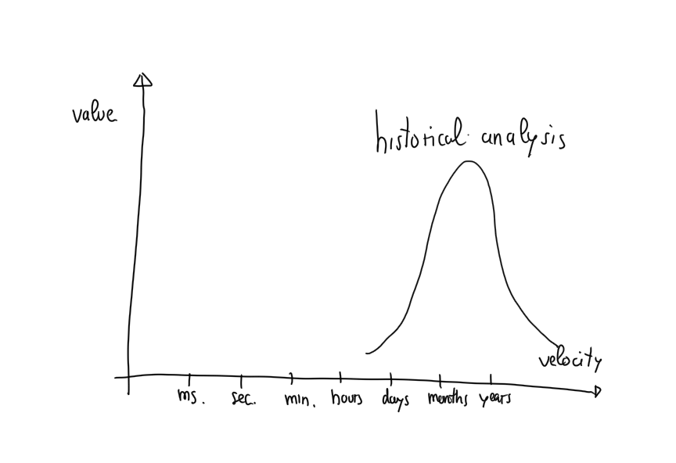

Slide 6
… struggling with prescriptive analysis …
What is the expected time to failure when that turbine starts to vibrate as detected in the last 10 minutes?
Can I get to that meeting in the next 15 min using public transport?
Who is driving the discussion about the top 10 emerging topics?
E. Della Valle

Slide 7
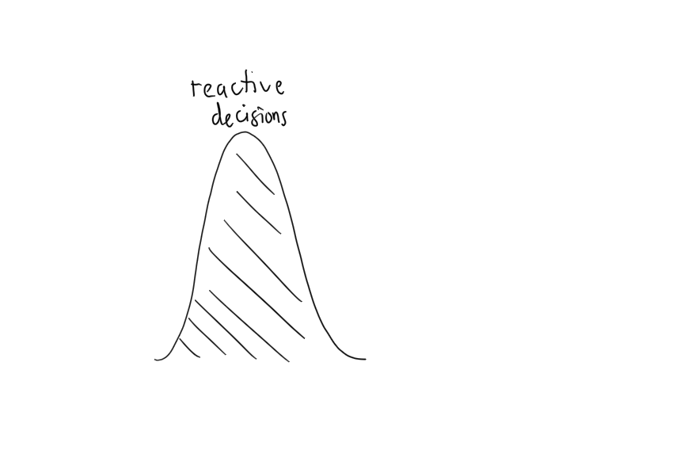

Slide 8

… to act in time

Slide 9
… while taking data-driven decisions
Descriptive
What happen?
Diagnostic
Why did it happen?
historical
analysis
Predictive
What will happen?
Data
Decision
Action
Decision Support
reactive decisions
Prescriptive
What should I do?
Decision Automation
[src. Gartner]
Machine-centered
Human-Centered

Slide 10
Introduction
Emanuele Della Valle Prof. @ Politecnico di Milano & Partner @ Quantia Consulting
Marco Balduini Founder & CEO @ Quantia Consulting
Riccardo Tommasini Prof. @ University of Tartu

